Slide 1
Selecting a cost effective Three
Test HTS Algorithm in South Sudan
RTCQI-Workshop, Cape Town-South Africa
June 3-7, 2024
National Public Health Laboratory - South Sudan

Slide 2
Background
South Sudan has a national HIV prevalence of 2.1% with about 40% coverage of 1st 95% (HIV spectrum estimates 2021).
Current WHO recommendation - three consecutively HIV-reactive test results to make HIV positive result. (WHO, 2019)
South Sudan adapted the WHO guidelines and conducted a lab verification to select assays for the new algorithm.

Slide 3
Study objectives
Main Objective
To select a cost-effective Three Test HTS Algorithm for South Sudan.
Specific objectives
To evaluate the performance characteristics of nine candidate products.
To identify suitable combinations of HIV rapid three assays.
To pilot the verified HIV 3-test algorithm.

Slide 4
Methodology
Cross-sectional laboratory-based study evaluating;
  False reactivity
  Inter-reader variability
  Inter-lot variability
  Invalidity

Slide 5
Study population and selection criteria
Inclusion criteria
Aged ≥18 years.
Exclusion criteria
People with documented HIV-positive status and or on ART.
Consented to participate in the study.

Slide 6
Study sites and sample size
  Five (5) facilities with relatively high patient volume and easy to access were selected
  Sample size of 250 participants was used, considered to be sufficient to detect at least 2–8% false-reactive results and determine level of false-reactivity

Slide 7
Study sites and sample size
Facility | General population, Sample size (N) | ANC population, sample size (N) | HIV Pre-screening blood donors, sample Size (N)
Clinic 1: Juba Teaching Hospital | 40 | 30 | 50
Clinic 2: Munuki PHCC | 20 | 15 | -
Clinic 3: Kator PHCC | 20 | 10 | -
Clinic 4: Gurei PHCC | 20 | 10 | -
Clinic 5: Nyakuron PHCC | 20 | 15 | -
Total | 120 | 80 | 50

Slide 8
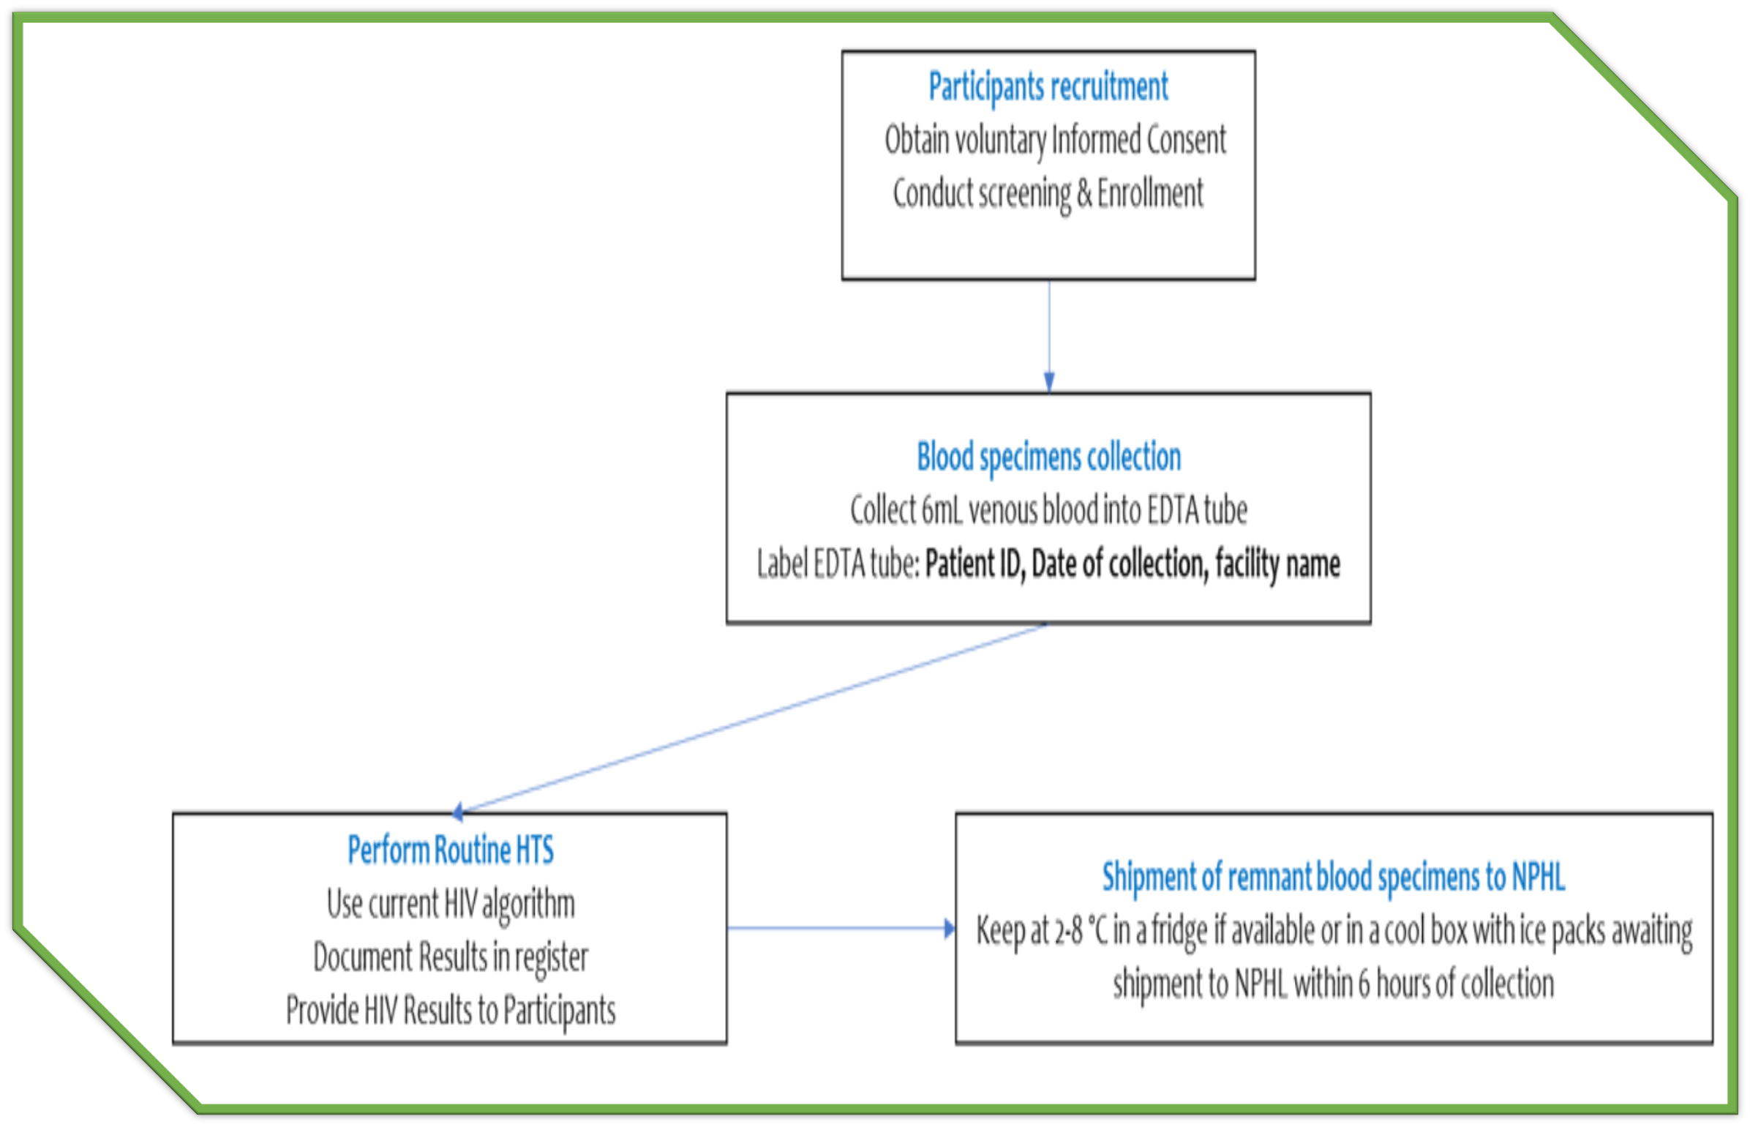
Facility workflow

Slide 9
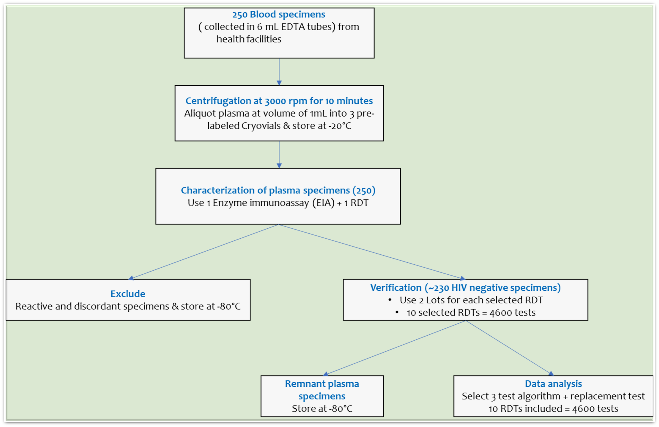
NPHL workflow

Slide 10
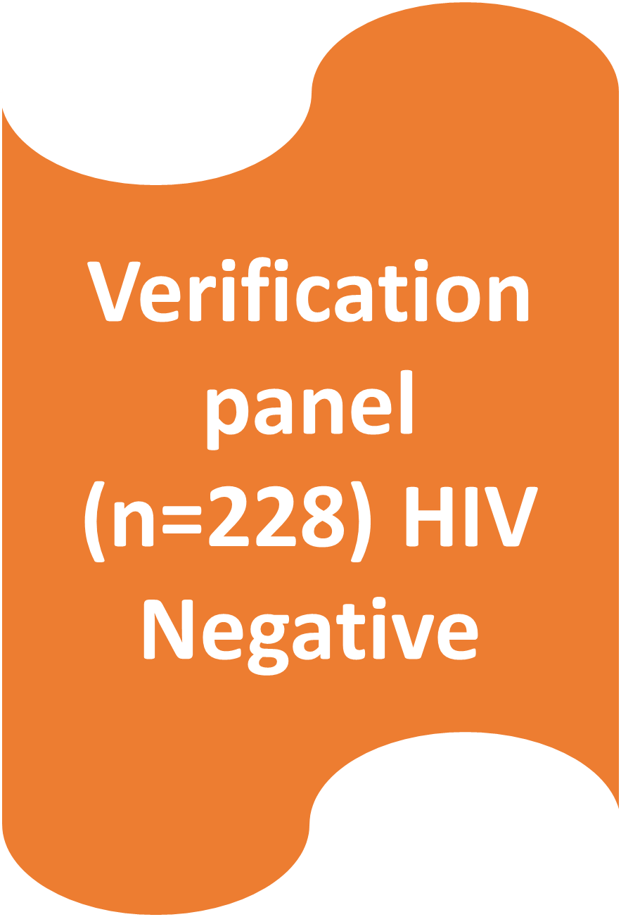
Samples characterization to rule out HIV

Slide 11
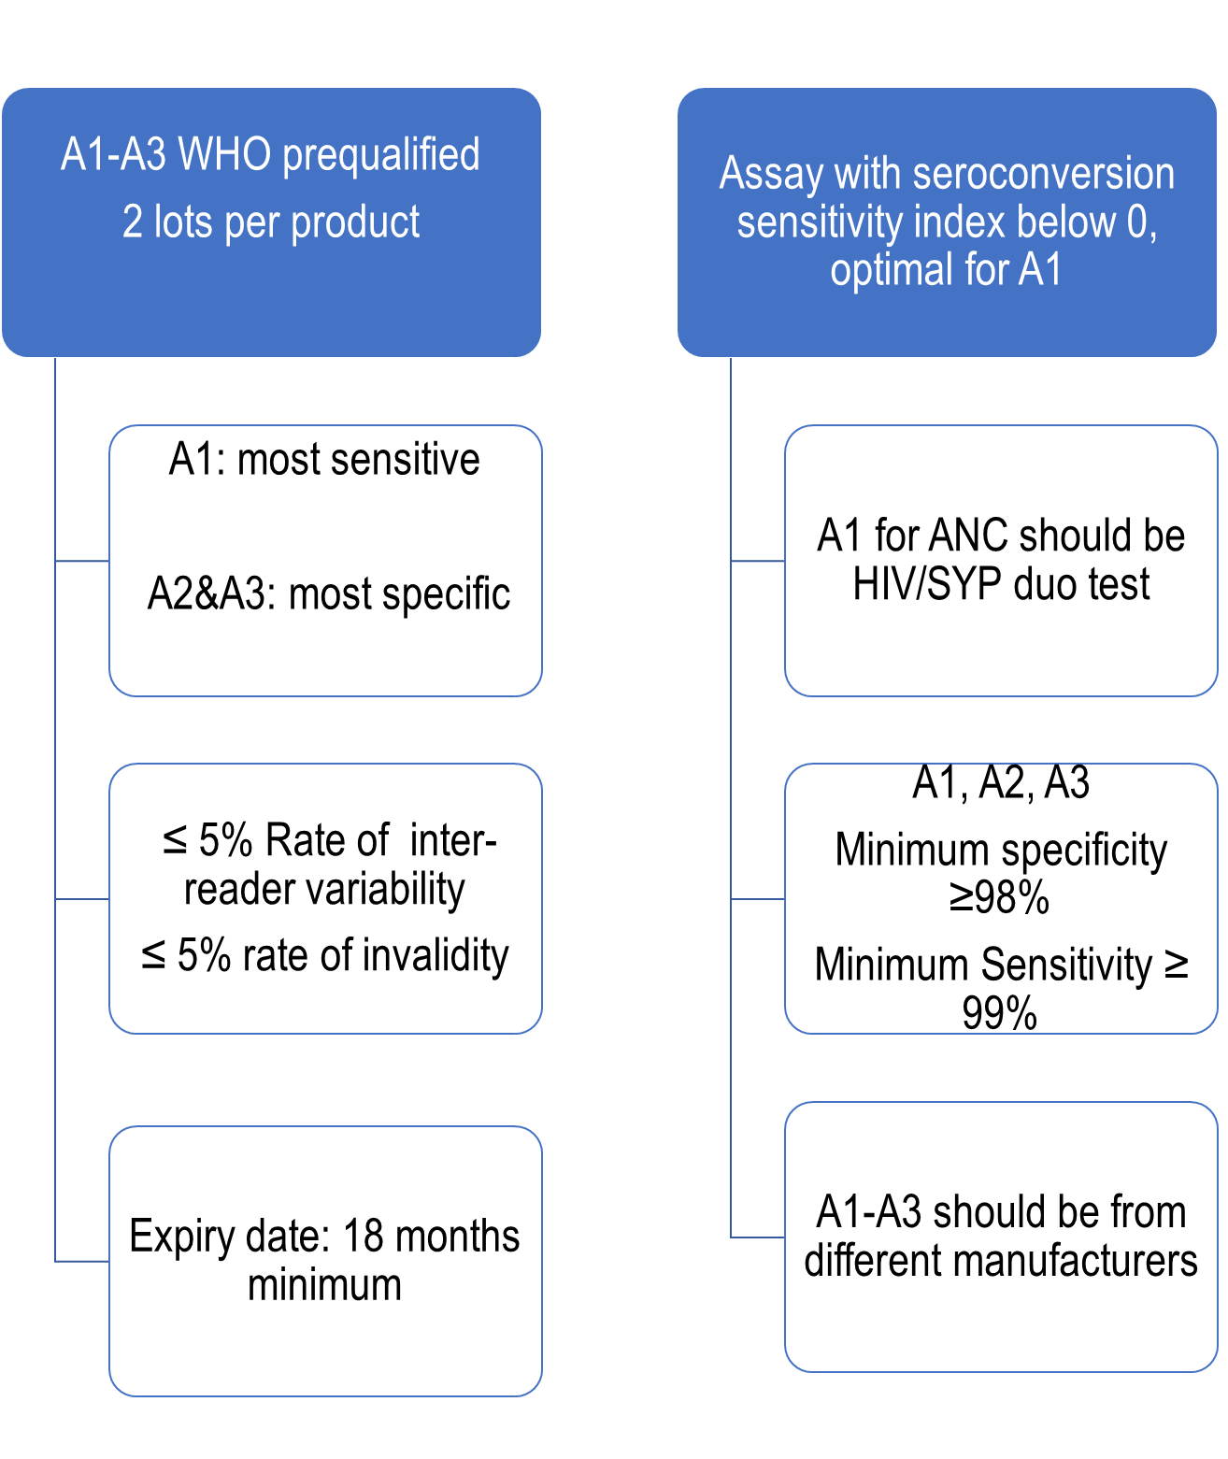
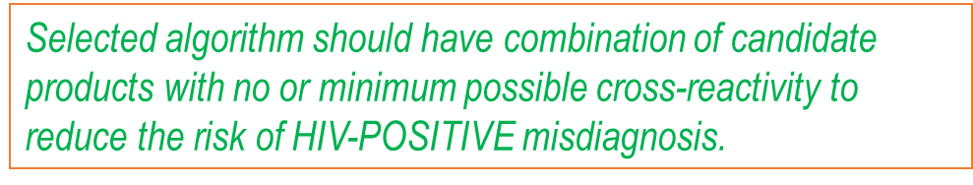
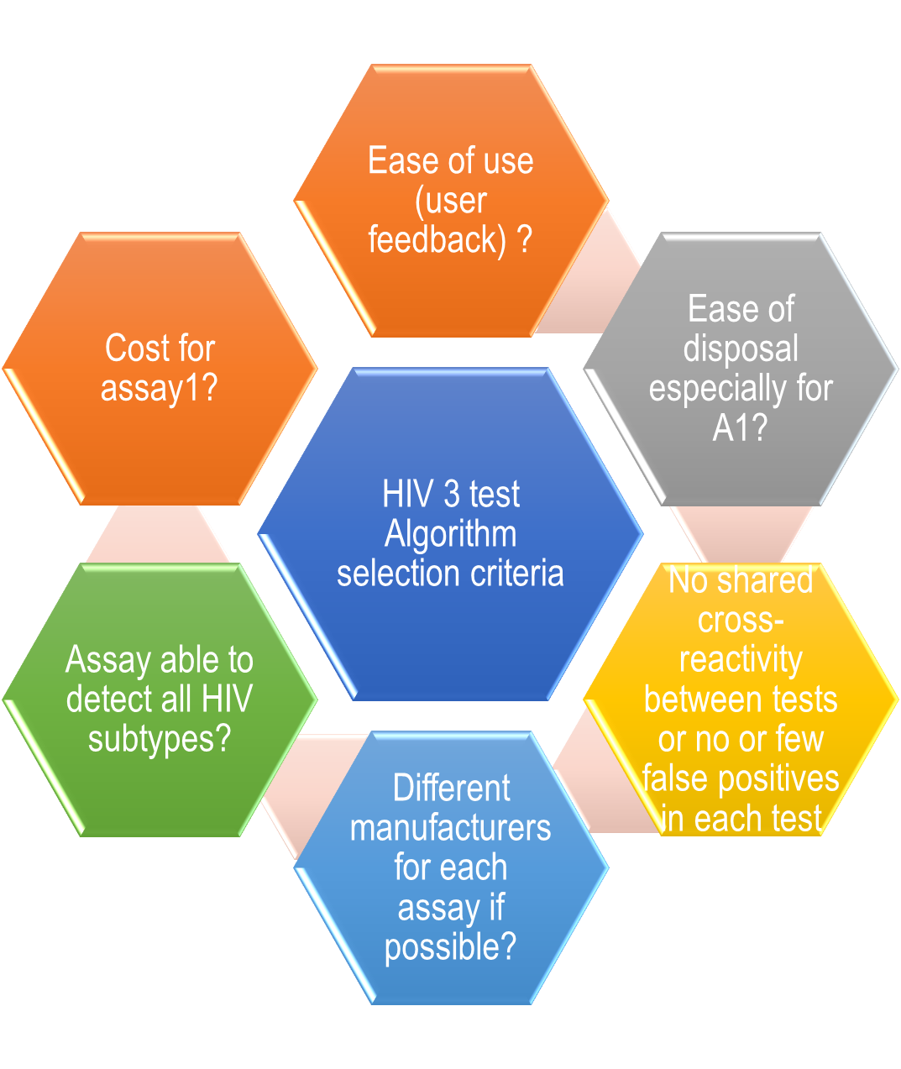
HIV candidate products selection criteria (phase 1)

Slide 12
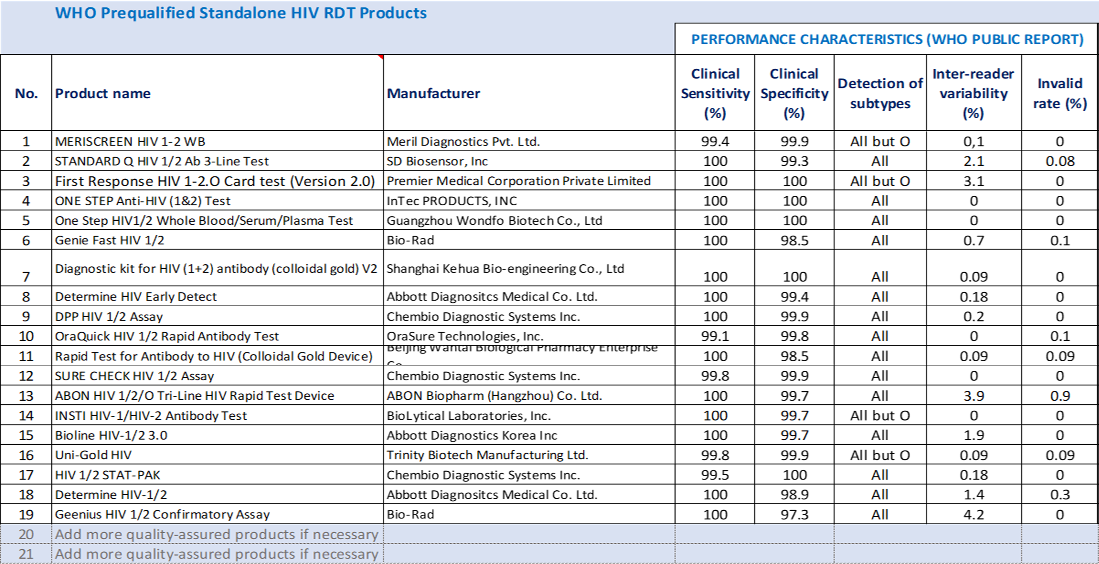
Shortlisting candidate assays based on performance characteristics

Slide 13
Shortlisting candidate assays based on performance characteristics (cont’d)

Slide 14
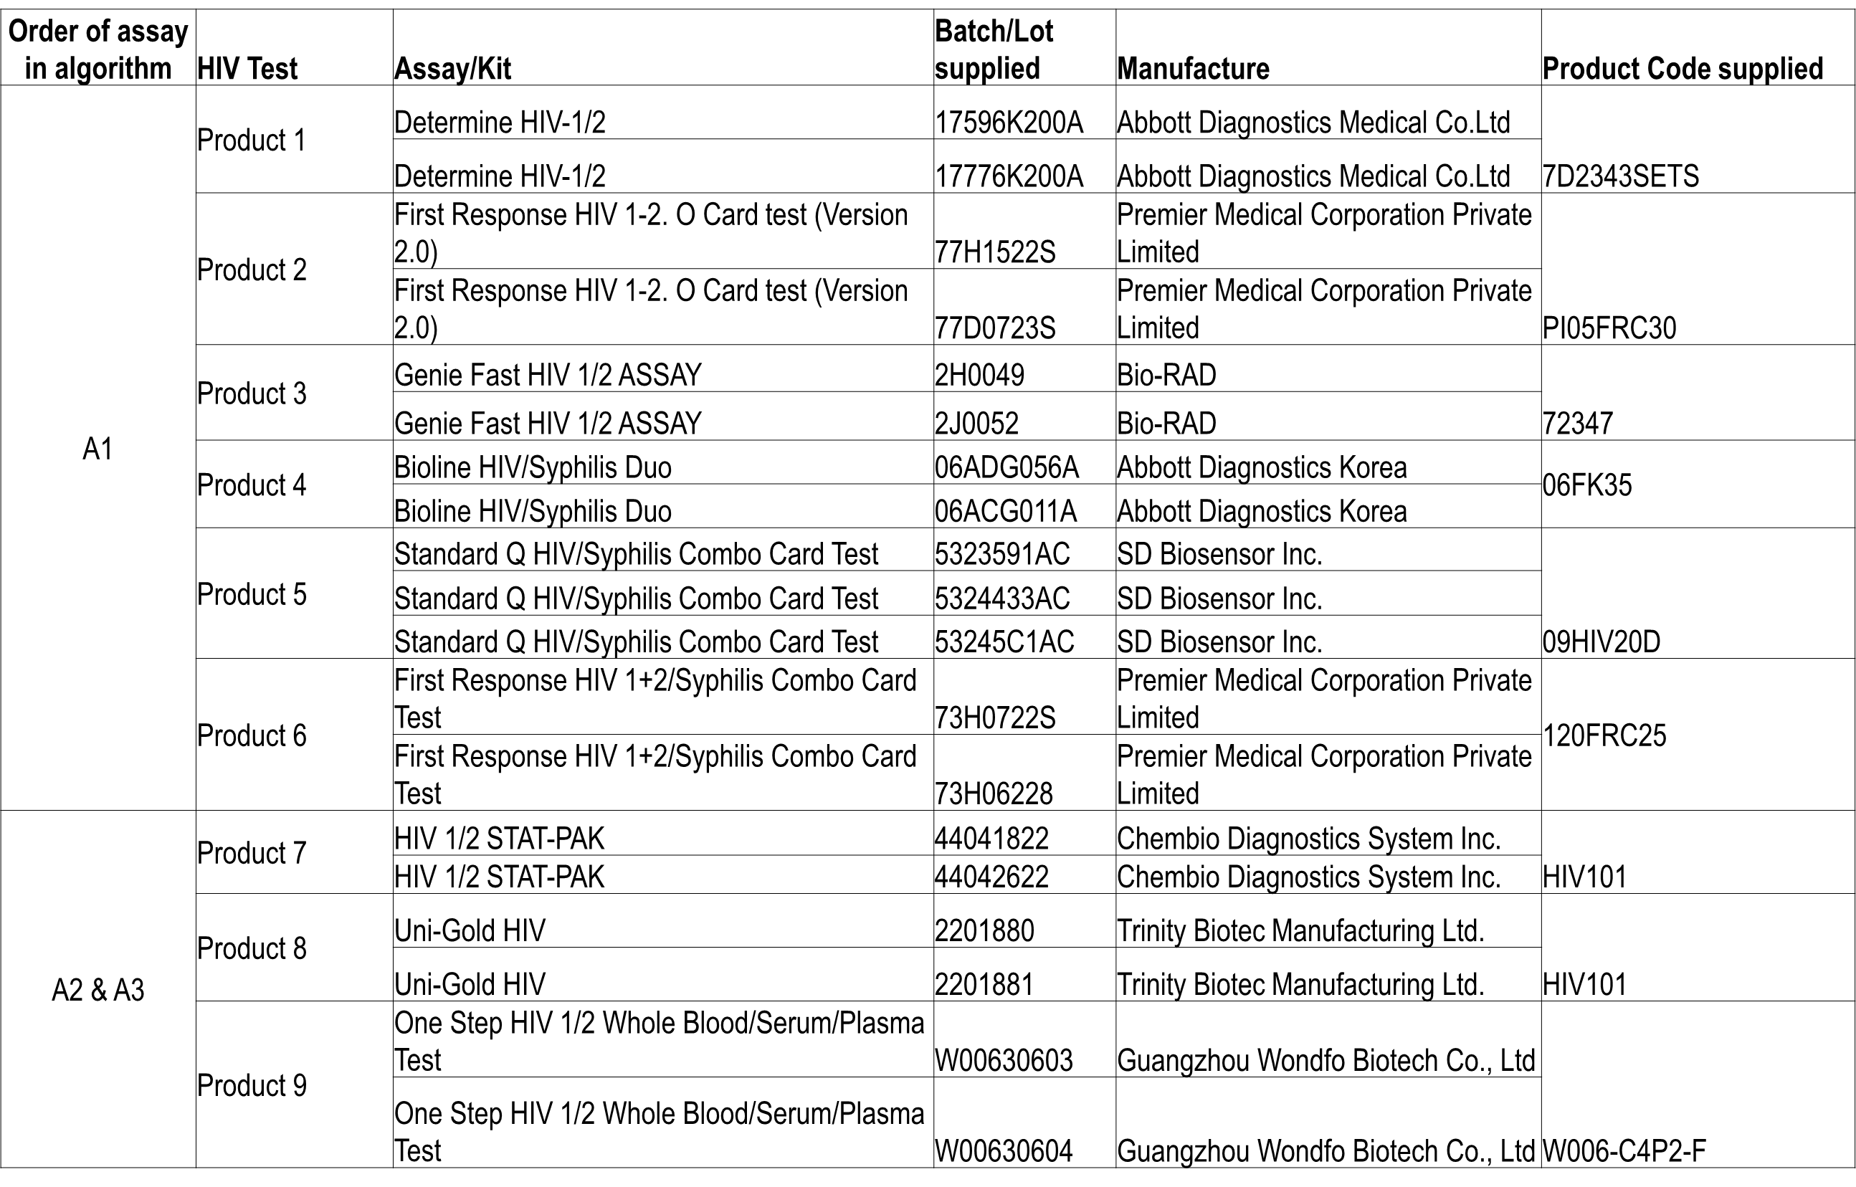
Products supplied for the study

Slide 15
Results of verification study

Slide 16
Shared false-reactivity (Obj 2)
Shared false-reactivity in one sample (JTH/OPD/37) identified between Determine HIV ½ test and SD Bioline HIV/SYP duo test (0.7%). Reactive with both lots in each test

Slide 17
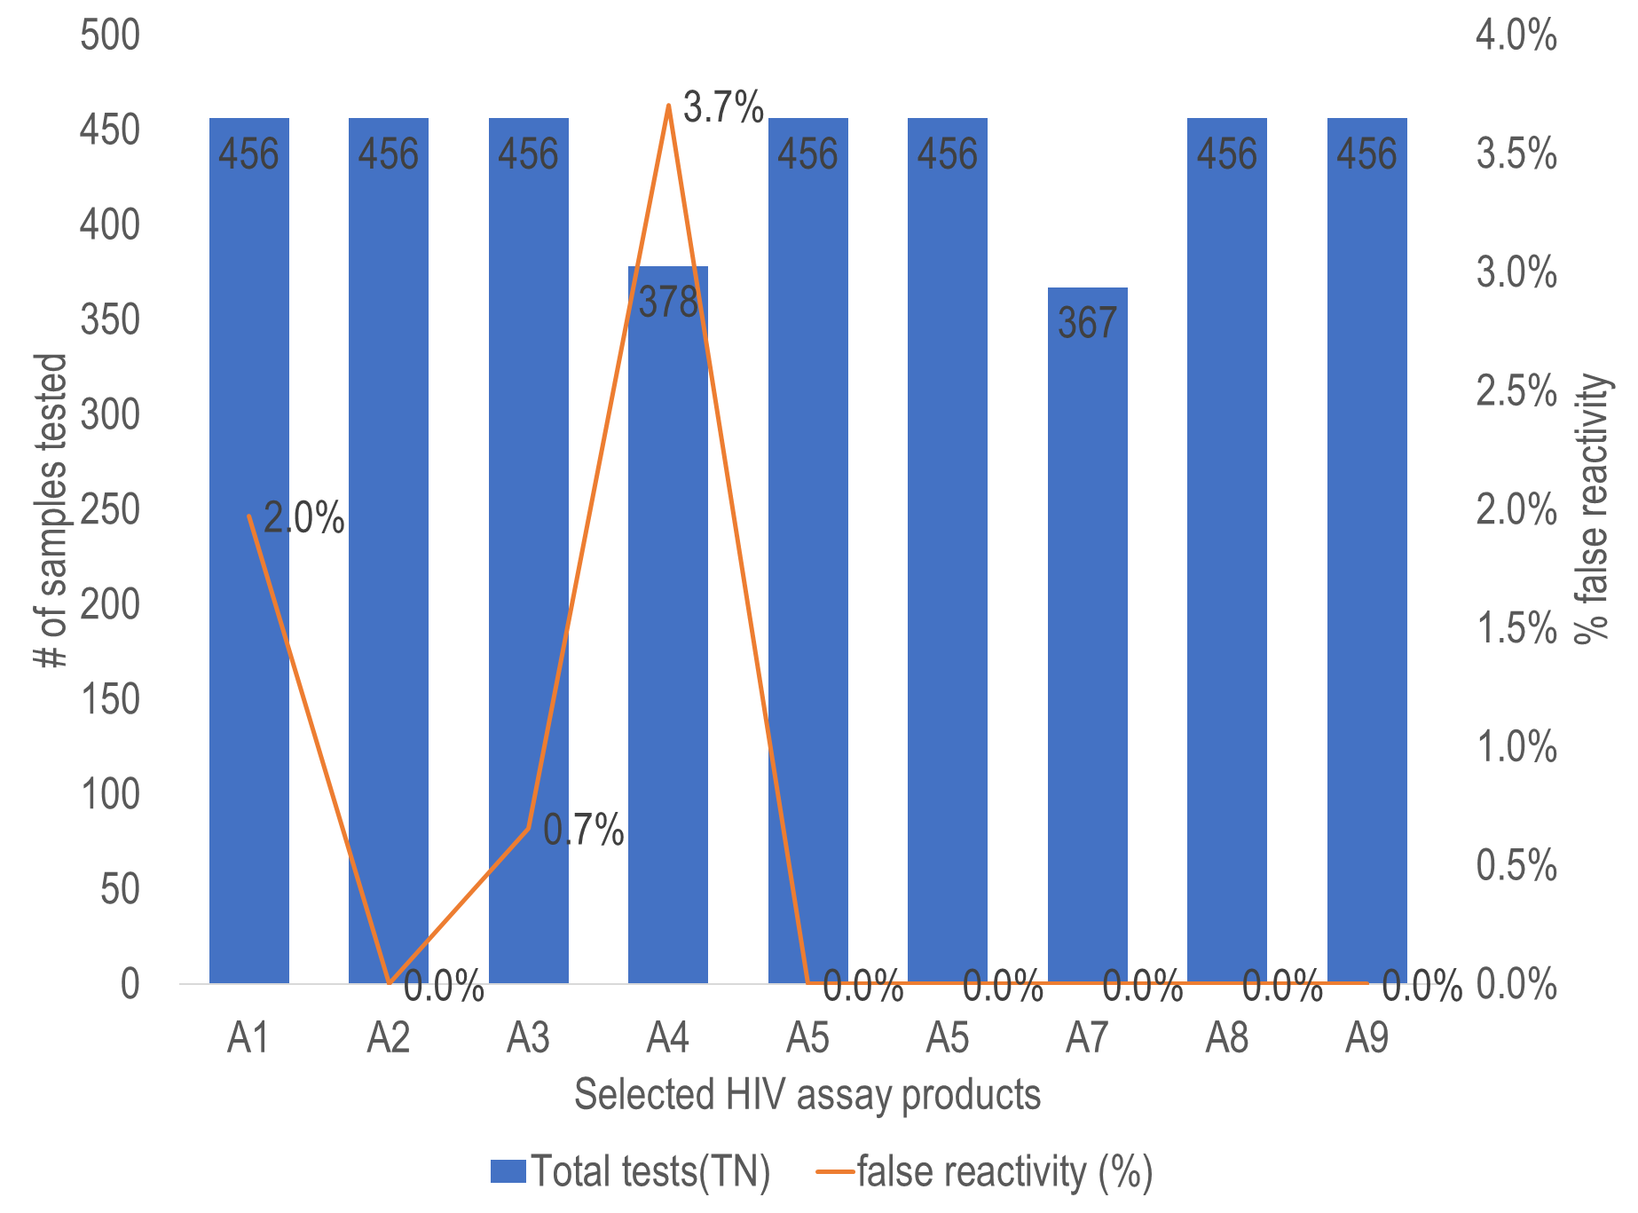
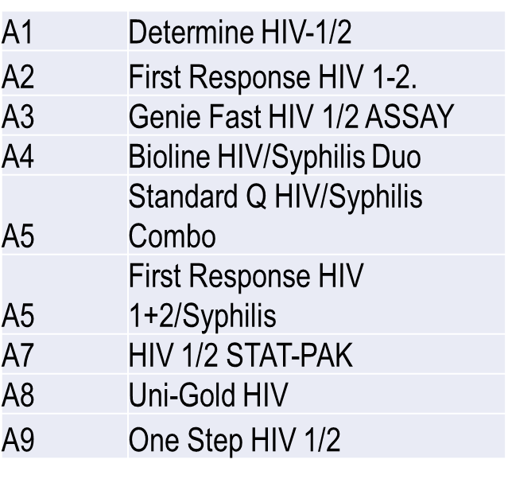
False reactivity rates among selected
HIV assays

Slide 18
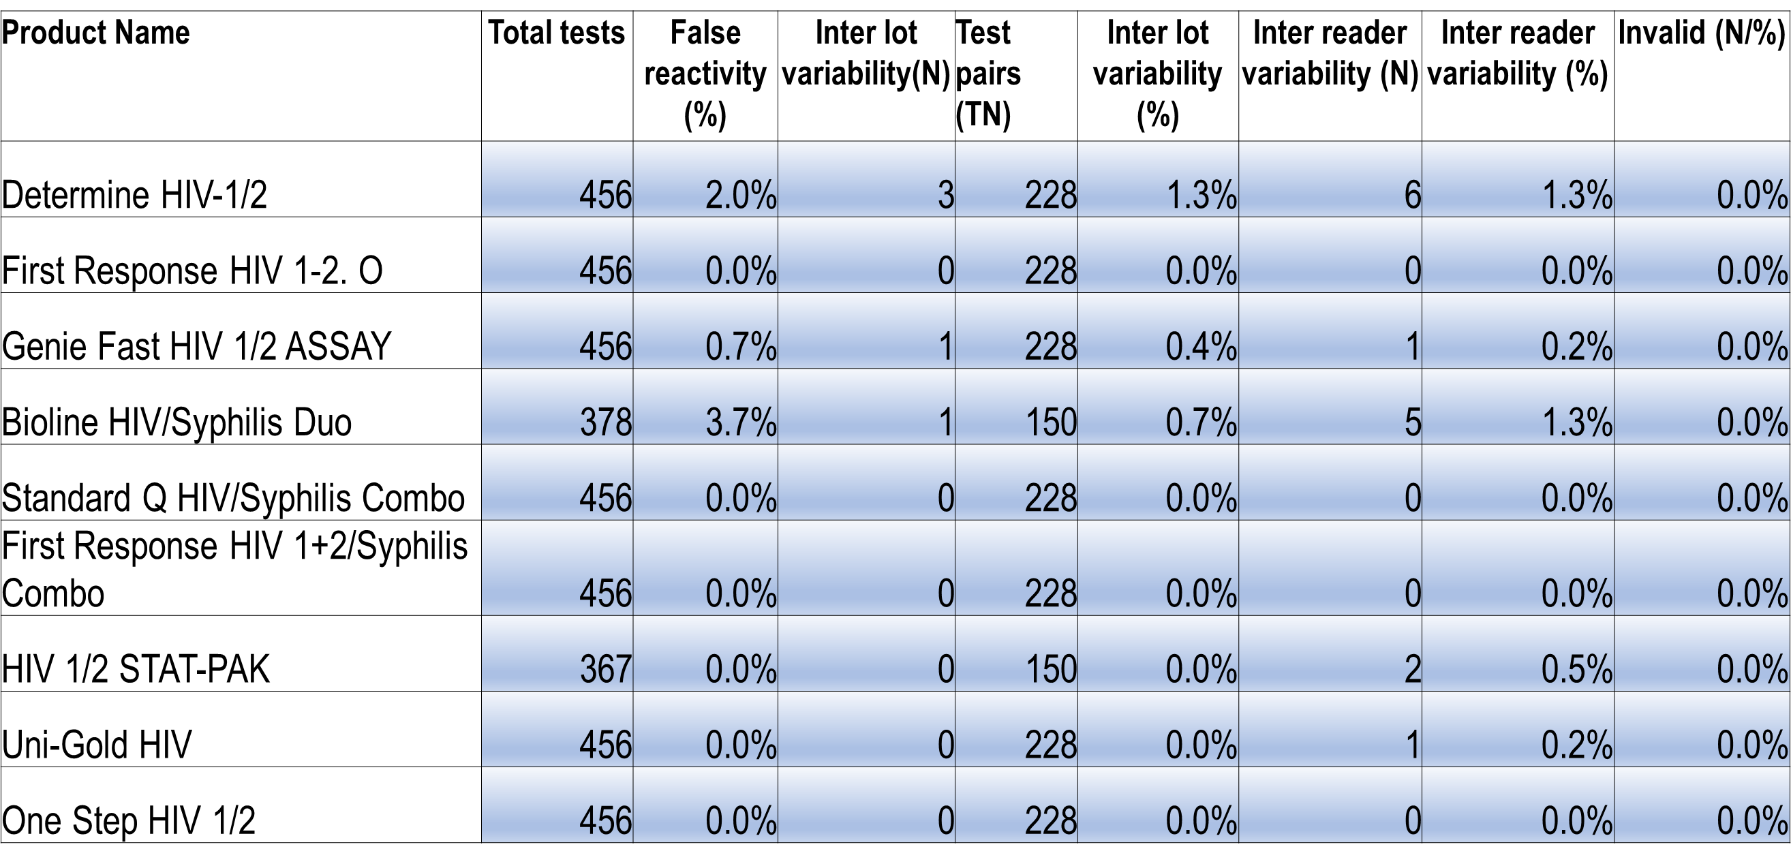
Inter-lot and inter-reader variability

Slide 19
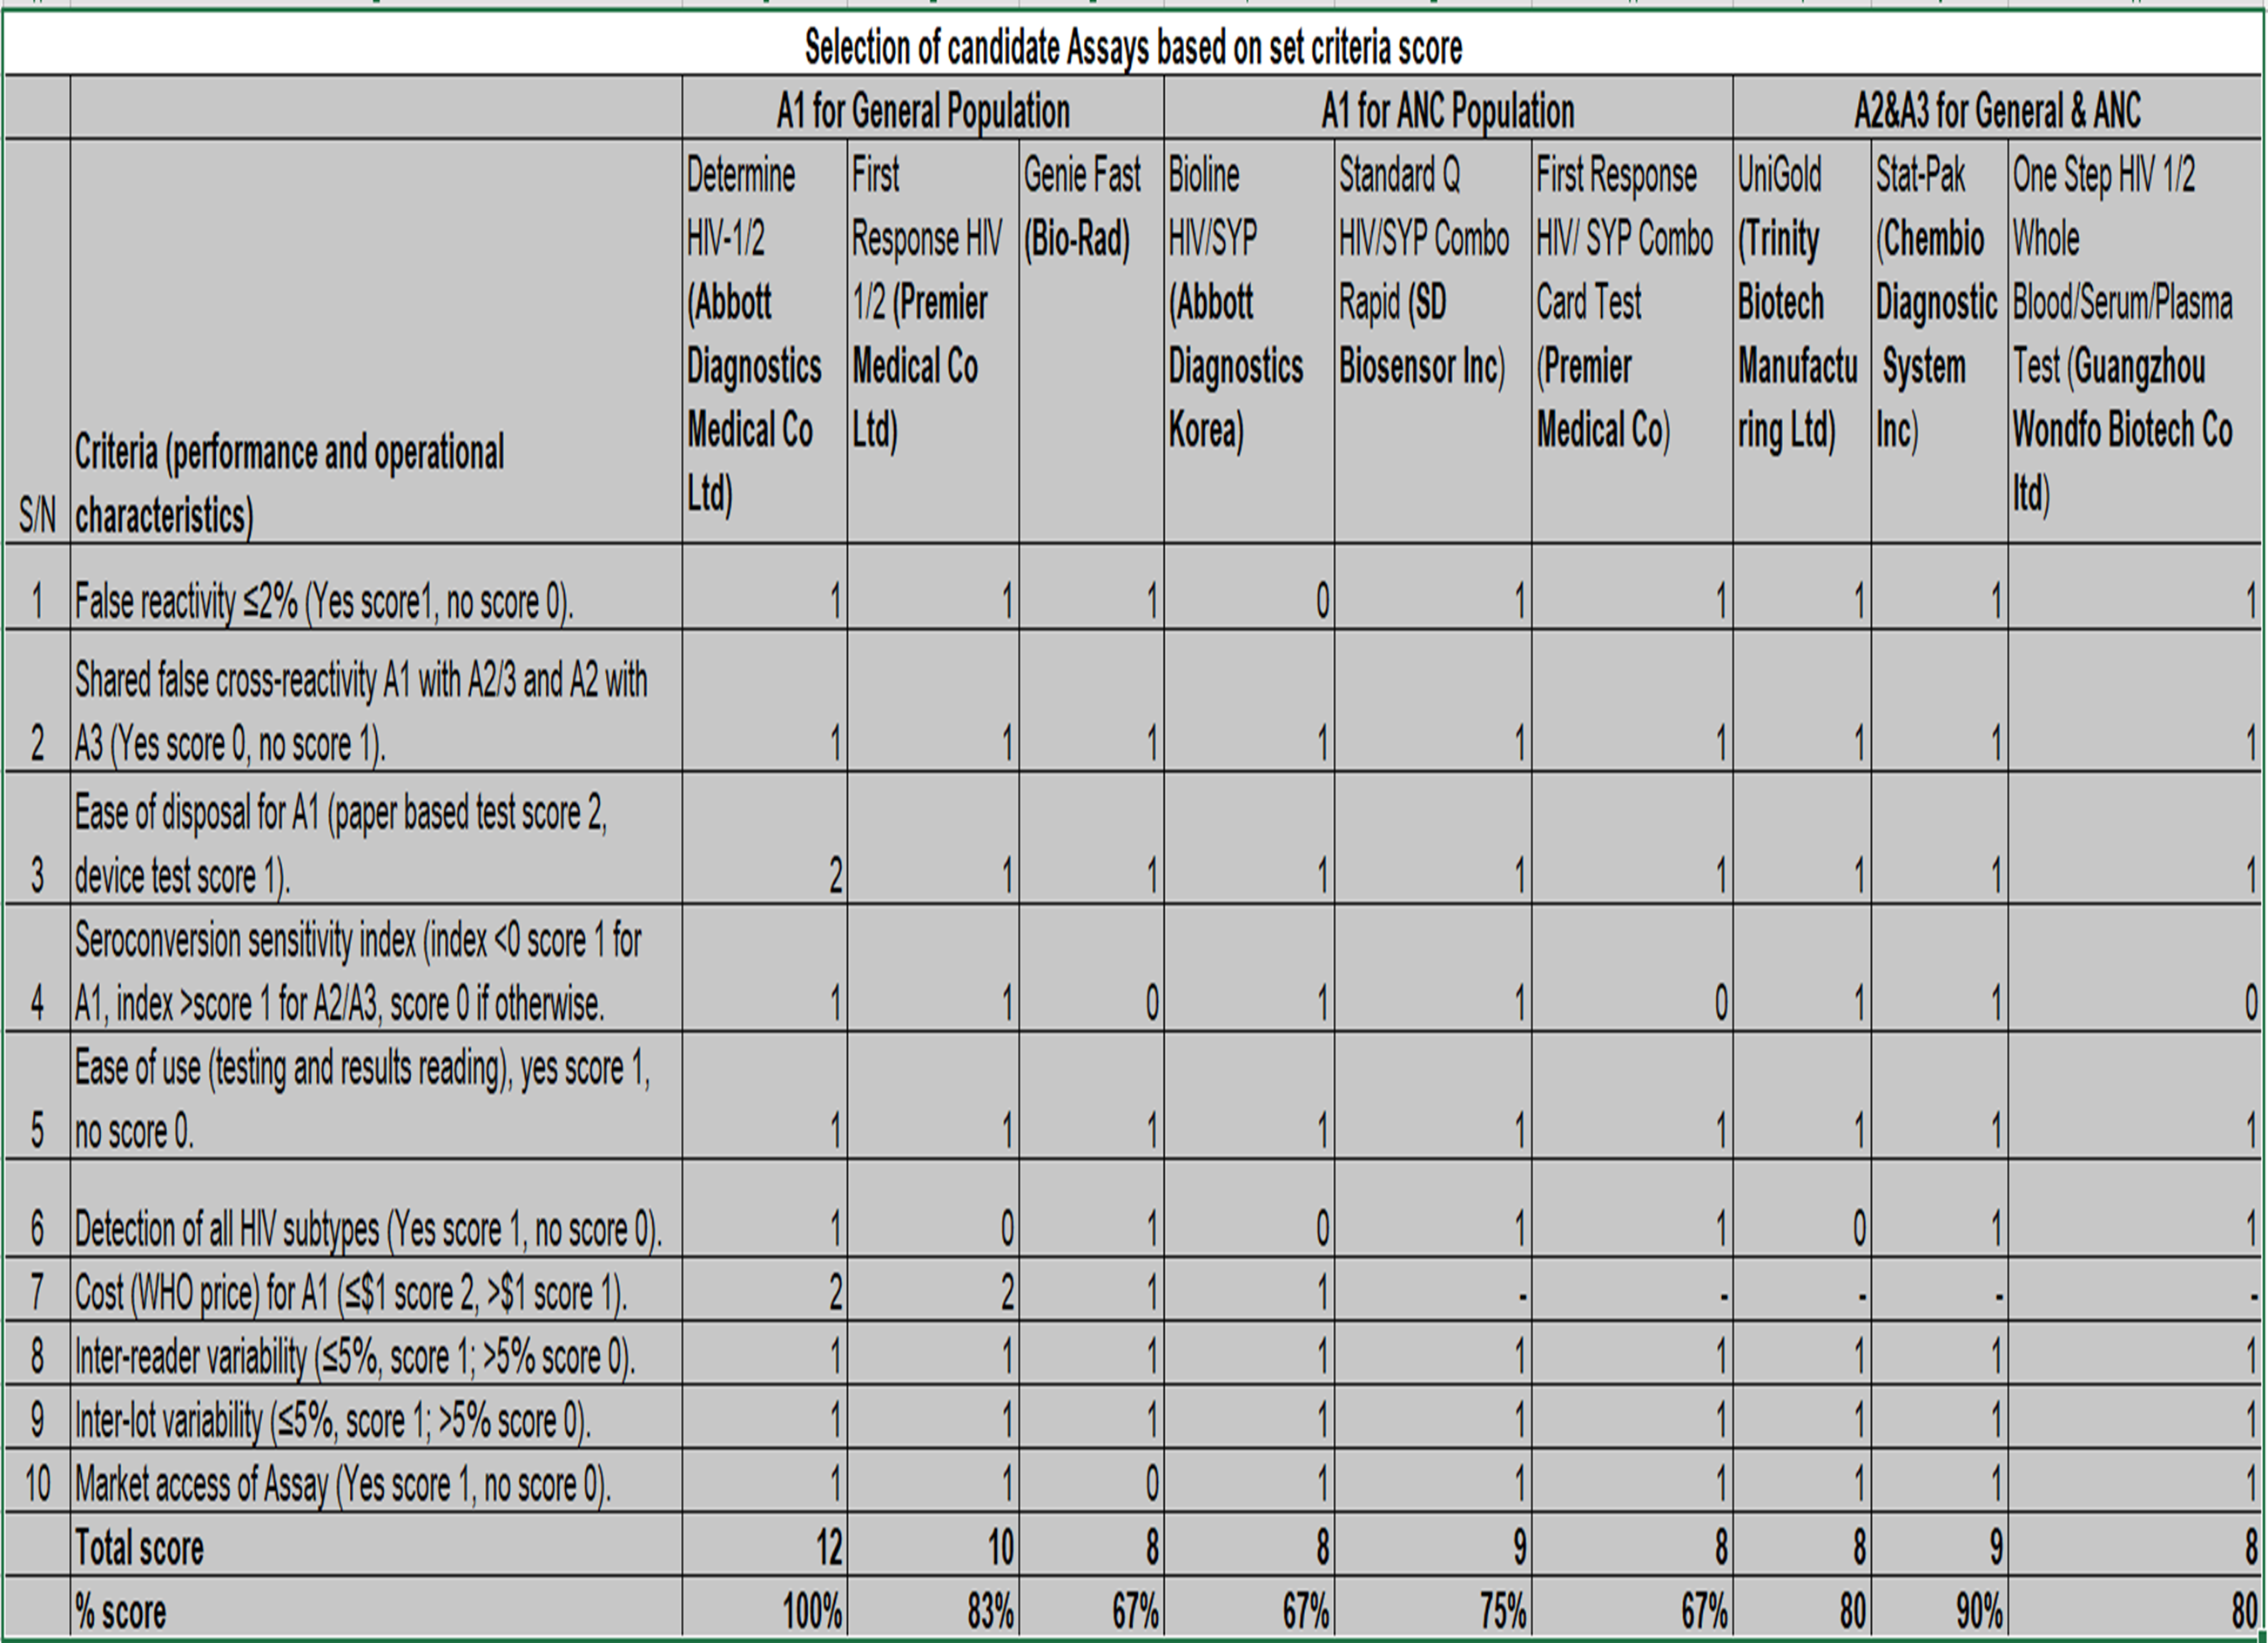

Slide 20
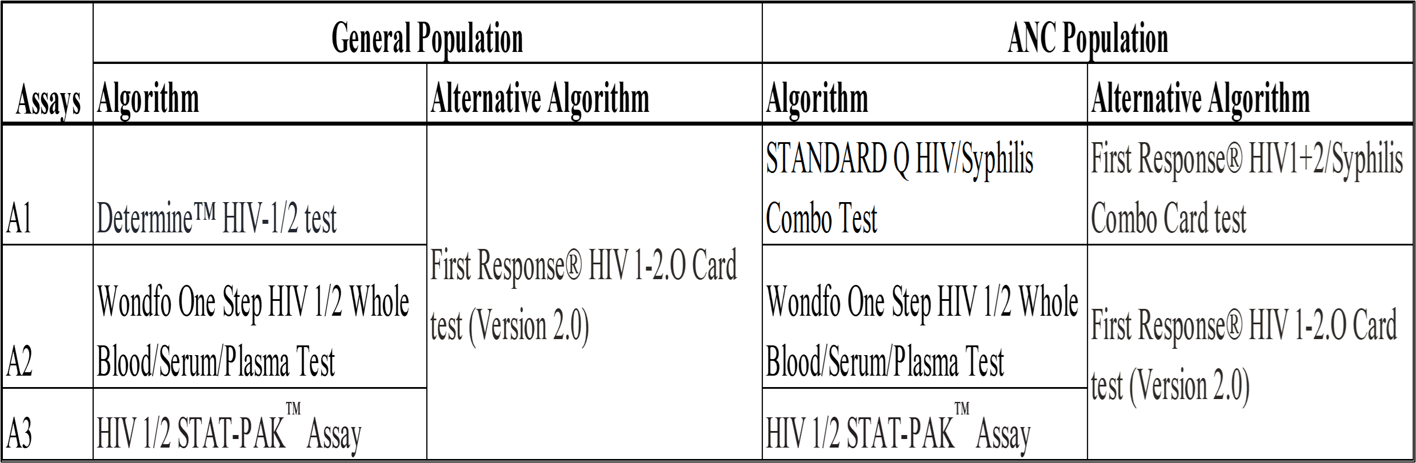
Proposed HIV 3 tests algorithms
One Step Whole Blood/Serum/Plasma was preferred to UniGold because it detects all HIV subtypes.

Slide 21
Next steps
  Conduct a pilot study for the selected Three-test Algorithm.
  Role out the selected Three-test Algorithm nationwide.
      Amend the SOPs, training materials and M&E tools such as registers.
      Procure the approved test kits.
      Conduct training.
      Role out the Three Test Algorithm.

Slide 22
Thank you

